Slide 1
Laser Drilling of Pia Mater
Neuralink, 2021/0007803, 1/14/2021
3/28/2024

Slide 2
Outline
Goal: Discuss methods for performing a pitomy (垂体瘤切除术) on a mammal including:
Performing craniotomy to remove skull and expose dura mater
Remove dura mater and arachnoid mater to expose subarachnoid space
Performing piotomy using laser to create a hole and expose cerebral cortex
Embodiments:
Cross-section of skull and meninges
Prior embodiment (2016) for implanting
9-Hole Experiement using the present embodiment (2021)

Slide 3
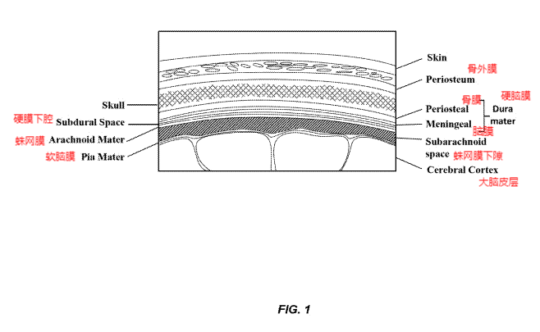
Cross-section of skull and meniges

Slide 4
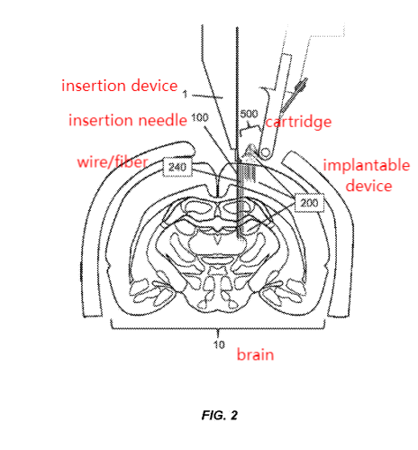
Without Removing Pia Mater
Referenced in WO 2016/126340
Uses needle on brain tissue without removing pia mater
Problem: Dimpoles --> slow down insertion process

Slide 5
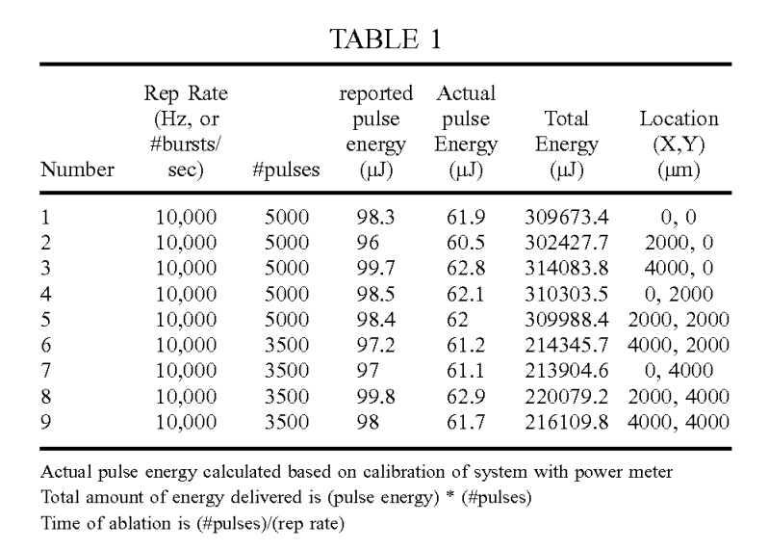
Laser-Drilling Pia Mater Experiment
Drill 9 holes through pia mater using a pulse-powered laser - reduce force of needle during insertion
Laser vaporizes water to form hole in pia mater
Test with insertion needle to see if dimples occur

Slide 6
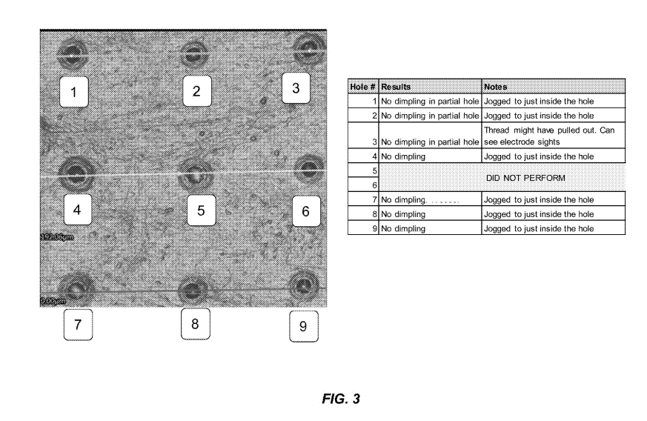
Experimetal Results
Experimental group: All other holes
Control group: Hole 5 & 6 not tested with needle
With needle - No dimpling (as expected)
--> Laser drilling of pia mater works as expected

